Slide 1

GOVERNMENT POLYTECHNIC BANTWAL DEPT OF COMPUTER SCIENCE & ENGINEERING
INTERNSHIP REPORT – 20CS61S
PATHWAY : AI&ML NAME : PAWAN
COMPANY : CODELAB SYSTEMS REG.NO : 163CS21034

Slide 2
CONTENTS:
INTRODUCTION
VISION & MISSION
ORGANIZTION STRUCTURE
ROLES & RESPONSIBILITIES
PRODUCTS & SERVICES
CONCLUSION
QUERIES

Slide 3
INTRODUCTION:
Codelab System is a rapidly growing company in the field of computer application Implementation, solutions and services.
Codelab System is a service provider of Web-based Development & Web based Software Development Solutions, Mobile Application Development, Graphic Design and Windows Applications.
Codelab Systems has the experience to undertake any IT development or deployment works on a single point responsibility basis.
Codelab Systems develop software and web-based applications with Latest Technologies.
Codelab Systems is always proactive to fulfill client’s needs and requirements.

Slide 4
VISION & MISSION
VISION:
To help people and businesses throughout the world realize their full potential.
Codelab inspiring vision statement seeks to support people.
You can see its intention isn’t about business; it’s about people and giving those people the services to be their best selves.
Codelab Systems are on a journey to be the trusted performance leader that unleashes the potential of data.

Slide 5
MISSION:
“To enable people and businesses throughout the world to realize their full potential and to organize the world’s information and make it universally accessible and useful.”
Every customer satisfaction is our business and we pay special attention to each client to provide best services.
The main goal of Codelab Systems is to provide best and innovative products that will help to drive potential customers to their businesses.

Slide 6
ORGANIZTION STRUCTURE:
ORGANISATION
MANAGEMENT
ADVISORY BOARD
MANAGING DIRECTOR
DIRECTOR
HEAD HR
HEAD ACCOUNTANT
HEAD IT OPERATIONS
HEAD TRAINING & DEVELOPMENT
HEAD BUSINESS OPERATION
HEAD ADMINISTARTION

Slide 7
ROLES & RESPONSIBILITIES:
Software Designing
Creation and Deployment of AI Algorithm
Data Analytics
Natural Language Processing
Building Data Science Infrastructure
Front-End Development

Slide 8

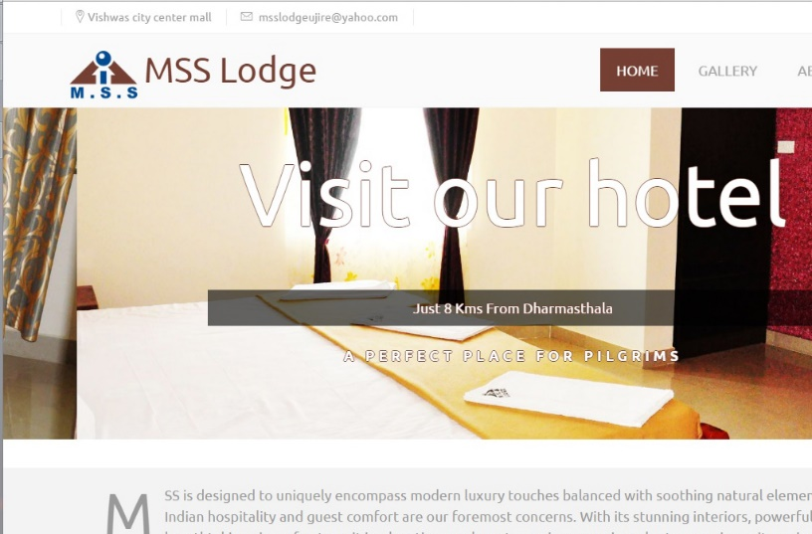
PRODUCTS & SERVICES:
SESCO:
SESCO is one of the first enterprises in the electrical equipment sector, perhaps in the Gulf region as a whole.
MSS Lodge:
MSS Lodge is a budget property located in the beautiful city of Ujire. This hotel offers gamut of facilities and in-roomamenities to all its guests to make their stay comfortable.

Slide 9
SERVICES:
Web Development
Professional Website
Mobile Application Platforms
Promotion
Graphics Designing
Others

Slide 10
CONCLUSION:
Codelab Systems' commitment to excellence, innovation, and client-centric approach positions it as a leading player in the IT industry, poised for continued success and expansion in the future.

Slide 11
QUERIES:
Any questions about this session?

Slide 12
THANK YOU

